Slide 1

Introduction to NodeJS

Slide 2
What is NodeJS
Simplest Definition: Javascript on your backend servers
Execution of javascript is done by VM(V8/Chakra)
NodeJS is a wrapper around VM like V8
On a larger context NodeJS is a wrapper around V8 with build-in modules providing rich features through easy to use asynchronous APIs
Node is platform for tools

Slide 3
Why Node?
Pros
Wrapper around V8/Chakra(execute Javascript)
Build-in feature reach modules like fs, httsp, crypto, zip,…
All them offers Asynchronous APIs (no threads)
Support for C++ addons
Debugger and other utilities
NPM - Node package manager (world largest connection of free and reusable package)
NPM comes with CLI which helps to install 3rd party code and also reuse the code
Module dependency manager

Slide 4
Cons
Different way of thinking – non blocking function
Picking good options – constantly research and pick best option
Small packages – i.e. mode pakcages

Slide 5
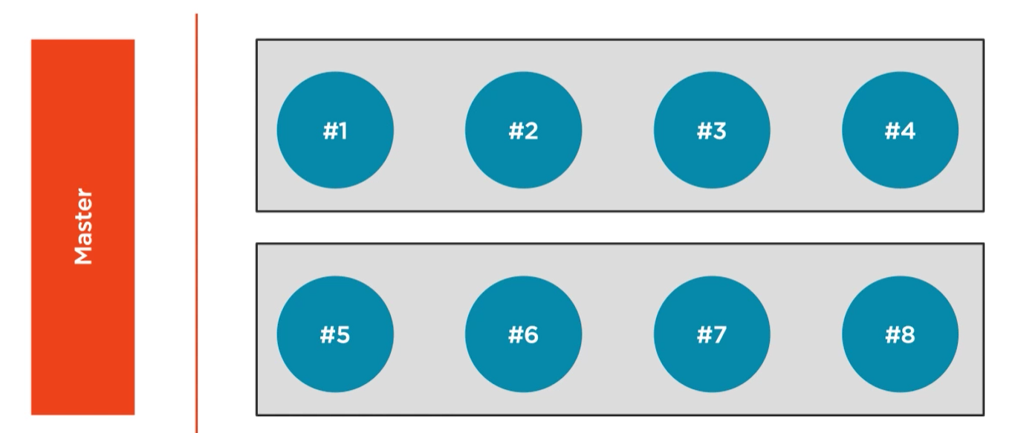
Why Node is names Node

Slide 6
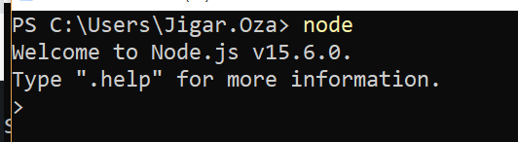
How to install Node
Open command prompt/Powershell and type node
If node is not installed on your machine, you can download lastest version of it from
https://nodejs.org/en/download/current/

Slide 7
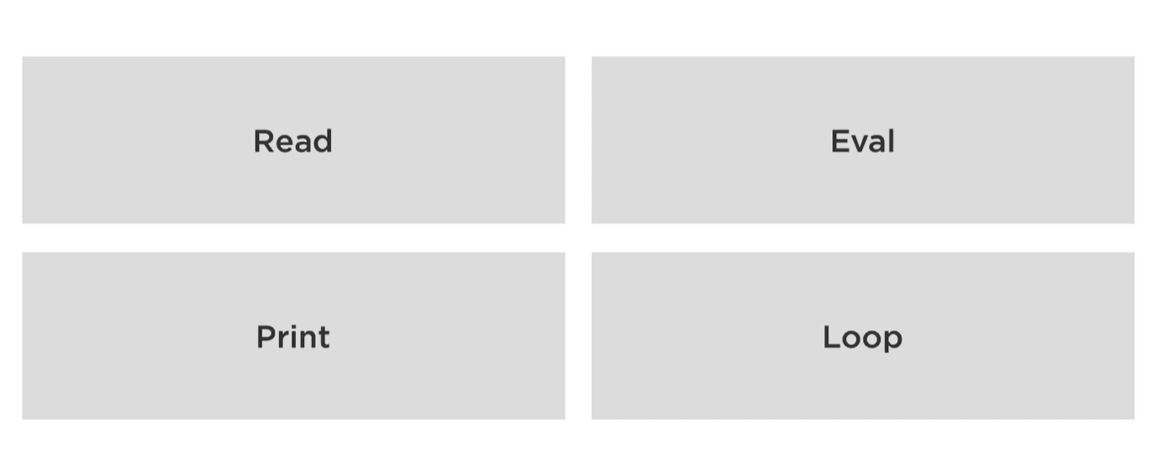
REPL

Slide 8
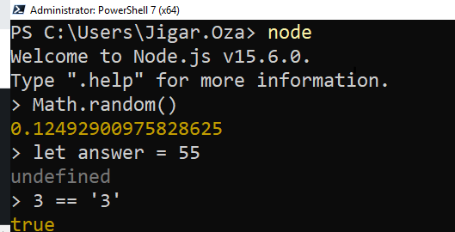
Read the line
Evaluate the line
Print the result, if there is no nothing to print Node will print ‘undefined’ as a result
Wait for next command in loop

Slide 9
REPL shortcuts
Ctrl + L will clear the REPL commands
Ctrl + D will exit the REPL session
.help will give you list of REPL commands
‘{‘ will allow to add multiple lines and REPL will wait before printing the result
If we have nested code like multiple ‘{‘ ‘.break’ will handle all unhandled ‘}’
‘.save’ will save REPL session to file

Slide 10
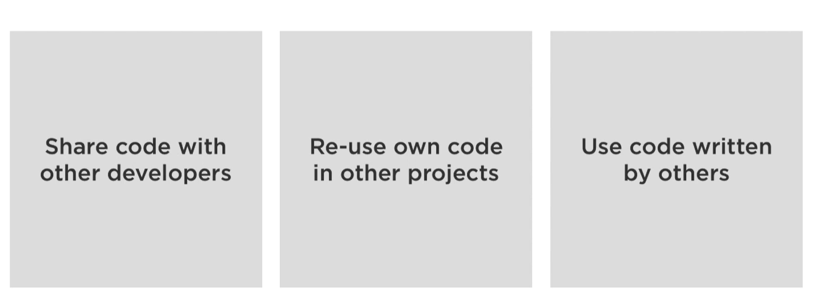




What is NPM?

Slide 11
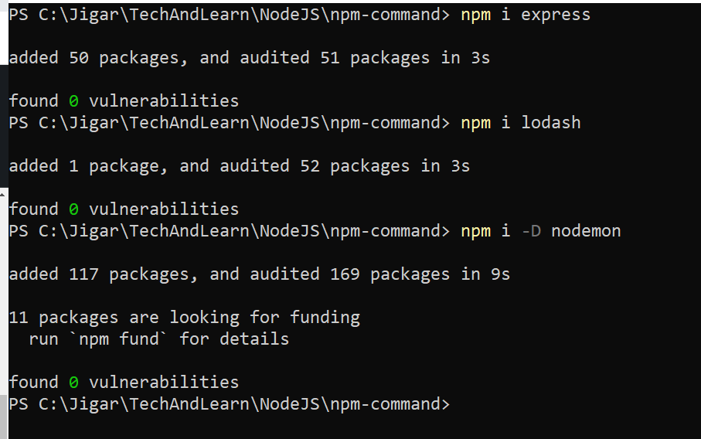
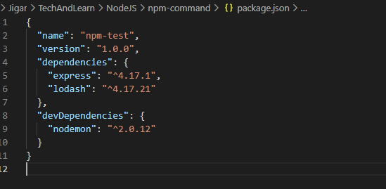
www.npmjs.com
Update NPM on your machine: npm install –g npm
npm i g lodash

Slide 12
NPM Semantic Versioning(SemVer)
1.2.3 →
1 – Major Breaking Changes
2 – Minor changes or new features are added with backward compatibility
3 – Patch bug fixes
~1.2.3 – when taken latest from NPM it will install 1.2.x where x >= 3
^1.2.3 – It will install 1.x.x where x >= 2
https://semver.npmjs.com

Slide 13
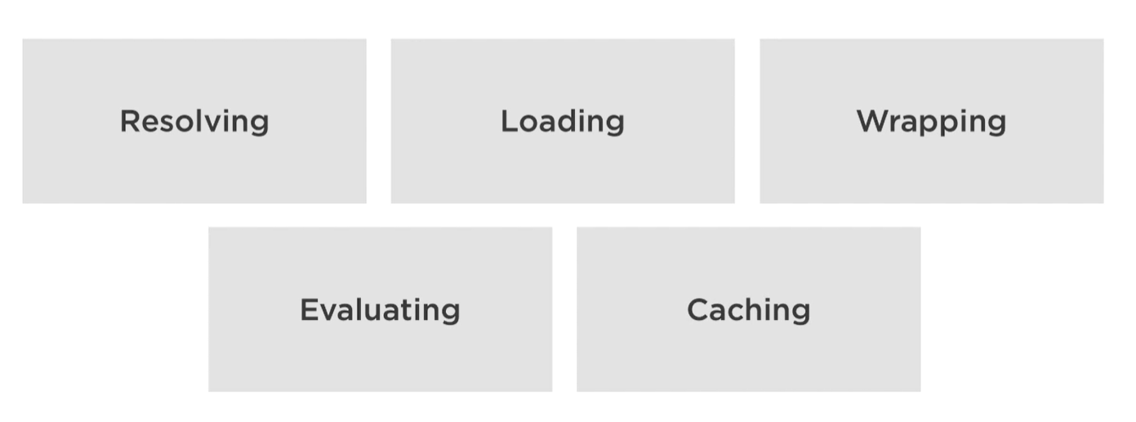
require(“module”)

Slide 14
Node internally calls JS files as function
Function(exports, required, module, __filename, __dirname)

Slide 15
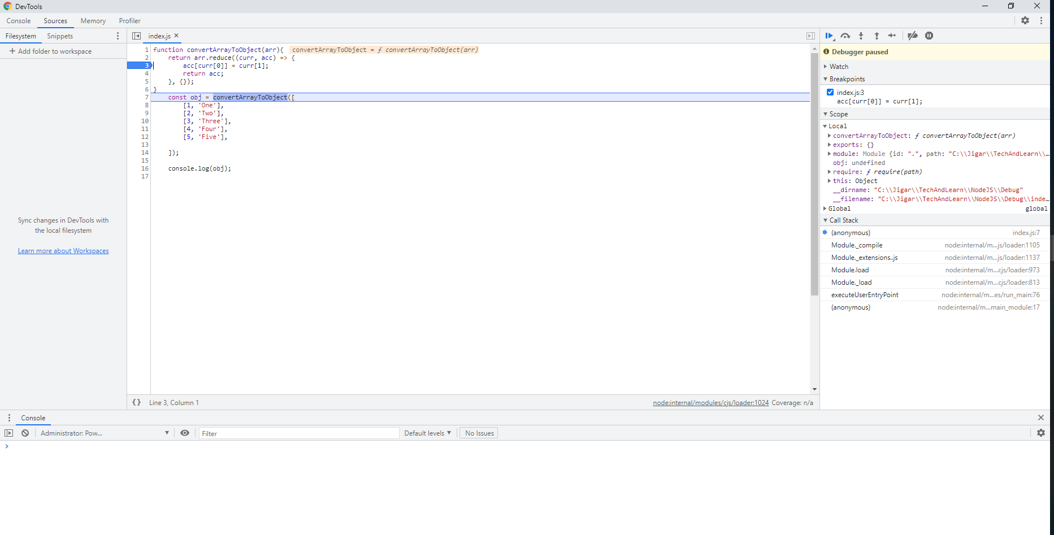
Debug Node
node --inspect-brk index.js
Chrome://inspect
Click on Inspect for your file

